Slide 1
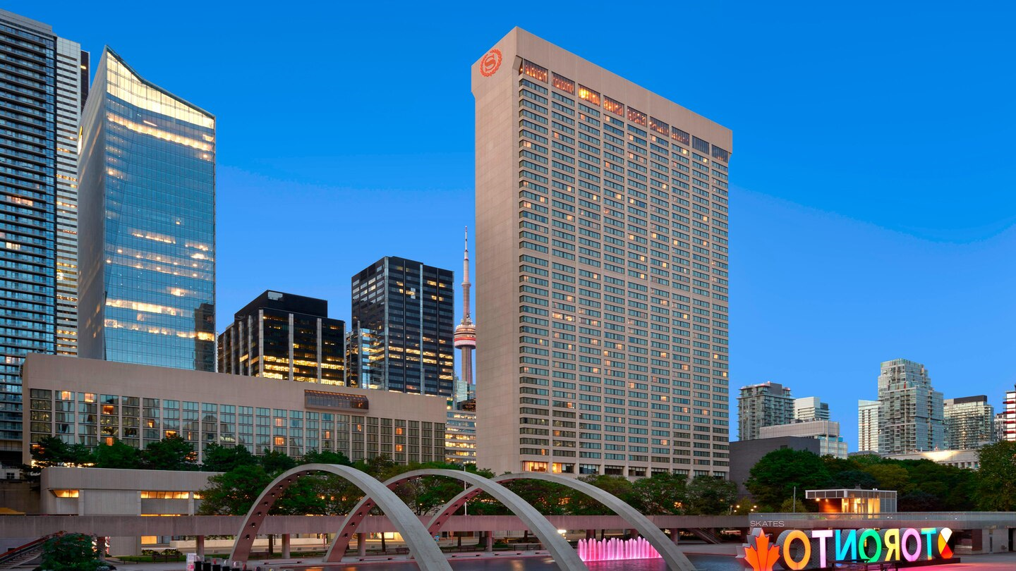

The Battle of Neighborhoods

Slide 2
Introduction
To explore Hotels in the city of Toronto.
Toronto is one of Canada's leading tourism destinations.
In 2017, the Toronto-area received 43.7 million tourists.
Tourists always try to find a nice stay in any city.
We will list and visualize all major parts of Toronto City that has great Hotels.
Also find out neighborhood in the city where potential hotel market is there.

Slide 3
Data Set
Toronto City data that contains list Boroughs, Neighborhoods along with their latitude and longitude.
Data source 1: https://en.wikipedia.org/wiki/List_of_postal_codes_of_Canada:_M
Data source 2: http://cocl.us/Geospatial_data
Hotels in each neighborhood of Toronto city.
Data source: Foursquare API
Description: By using this API we will get all the venues in each neighborhood. We can filter these venues to get only Hotels.

Slide 4
Approach
Collect the Toronto city data from Data Source 1 & 2
Using Foursquare API we will find all venues for each neighborhood.
Filter out all venues that are Hotels.
Find rating, tips and like count for each Hotel using Foursquare API.
Using rating for each Hotel, we will sort that data.
Visualize the Ranking of neighborhoods using folium library(python)

Slide 5
Answerable Questions
What is best location in Toronto City for Hotel Stay?
Which areas have potential Hotel Market?
Which all areas lack Hotels?
Which is the best place to stay if I prefer nice Hotel Stay?

Slide 6
Analysis
We will import the required libraries for python.
pandas and numpy for handling data.
request module for using FourSquare API.
geopy to get co-ordinates of City of Toronto City.
folium to visualize the results on a map
The code for rest of the analysis can be seen here.

Slide 7
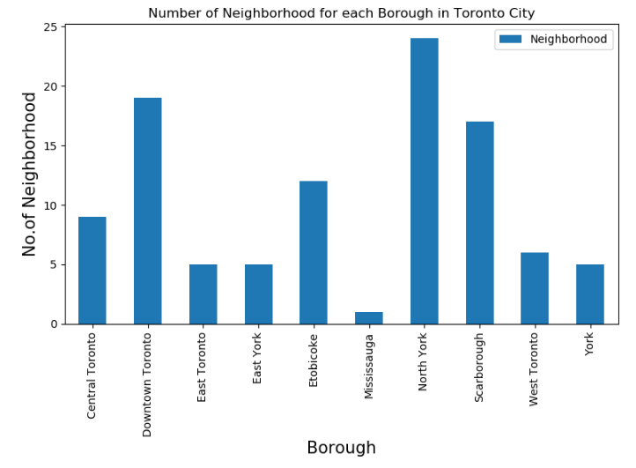
Results
1 of 6
North York has the highest number of neighborhoods.

Slide 8
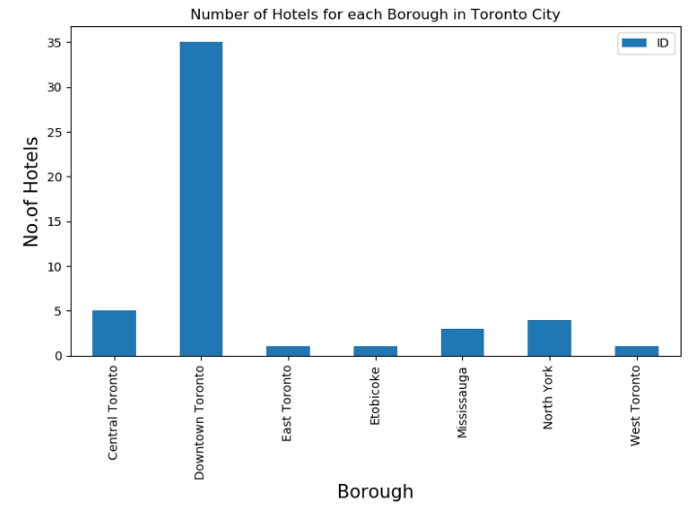
Results
2 of 6
Downtown Toronto has maximum number of Hotels.

Slide 9
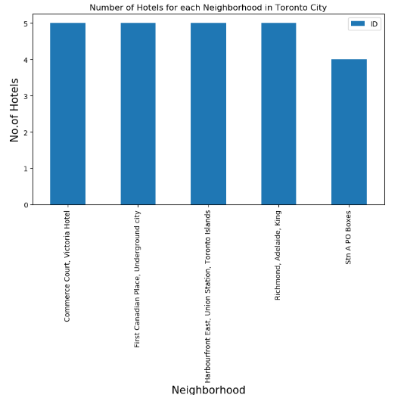
Results
3 of 6
Four Neighborhoods have same number of Hotels (5 Hotels).

Slide 10
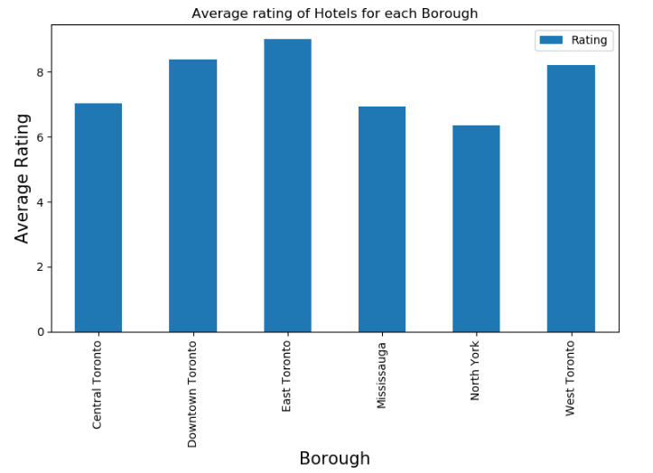
Results
4 of 6
East Toronto has highest average rating of Hotels.

Slide 11
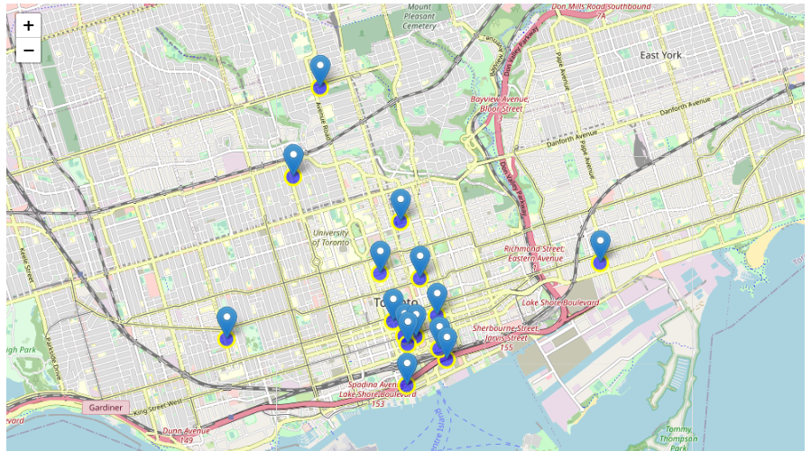
Results
5 of 6
Best Neighborhoods in Toronto which have highest average rating of Hotels.

Slide 12
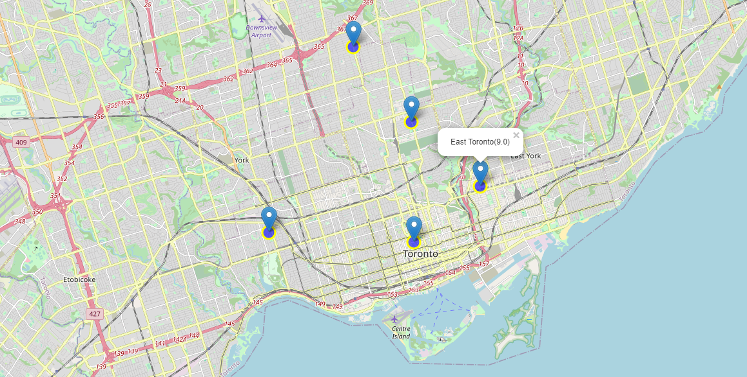
Results
6 of 6
Best Borough in Toronto which have highest average rating of Hotels.

Slide 13
Discussion & Conclusion
Studio District (East Toronto), St. James Town (Downtown Toronto), are some of the best neighborhoods for Hotel Stay.
Downtown Toronto have potential Hotel Market.
Willowdale, Willowdale East ranks last in average rating of Hotels.
Downtown Toronto is the best place to stay if you prefer Variety of nice Hotel Stays.

Slide 14
Limitations
The ranking is purely on basis of rating of Hotels.
The accuracy of data depends purely depends on the data provided by FourSquare.

